Slide 1

Leads scoring

Slide 2
Problem Statement: 1
X Education sells online courses to industry professionals..
The company receives leads from various sources, including website visits, form submissions, and referrals.
Currently, their lead conversion rate is low, approximately 30%.
The company aims to increase efficiency by identifying potential leads ('Hot Leads') with a higher likelihood of conversion.

Slide 3
Problem satement: 2
Present the overall approach of the analysis in a presentation.
Identify the missing data and use an appropriate method to deal with it.
Identify if there are outliers in the dataset.
Identify if there is a data imbalance.

Slide 4
Approach and methodology:
Importing numpy,pandas, seaborn,matplotlib and warnings.
Getting info abt Data
Removing columns or cells containing null values greater then 40%
And also replacing null values which are less the 40% in that particular column
After getting required columns perform analysis by observing graphs

Slide 5
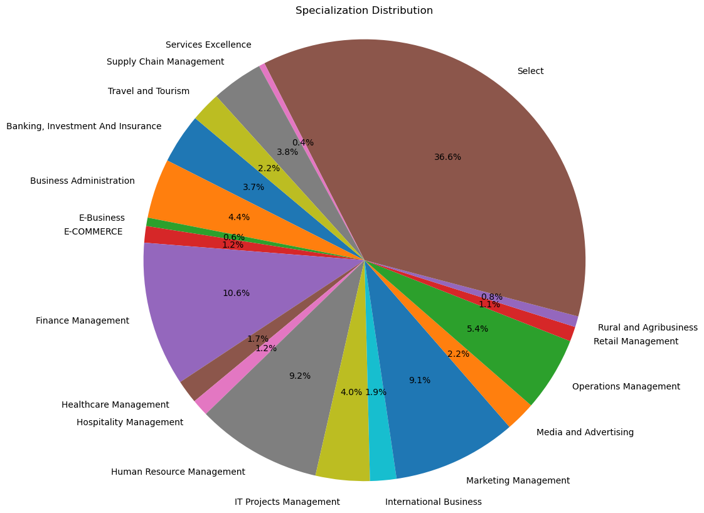
Graphs:
Pie chart shows %of type
Their specialization
Need to observe it carefully
Where to target

Slide 6
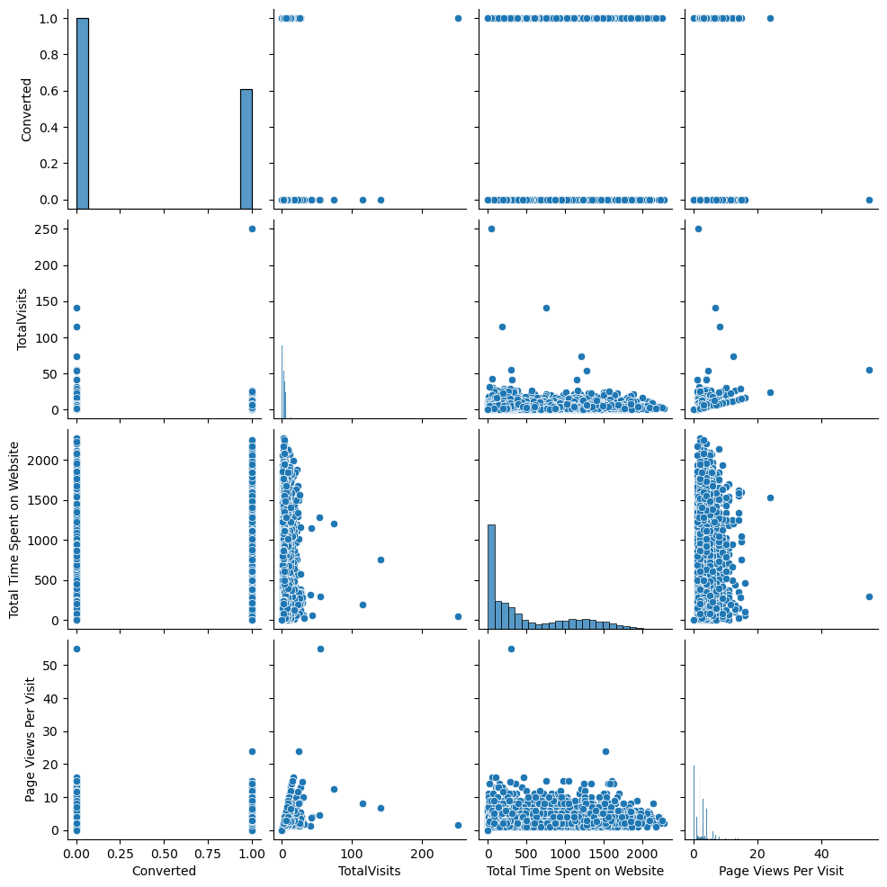
Plots of imp variables.

Slide 7
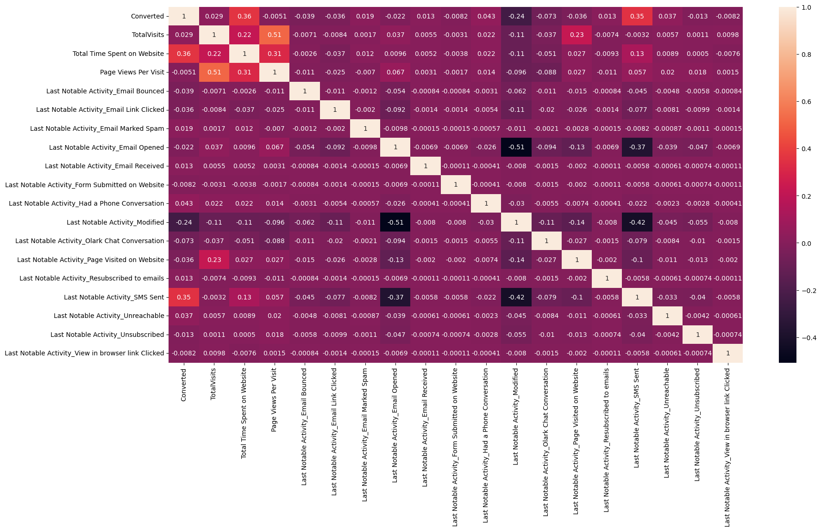
Correlation of imp data columns:

Slide 8
various machine learning models such as logistic regression(RFE)
Assess models' performance using metrics like accuracy, precision, recall, and ROC AUC.
Developed a lead scoring system based on the chosen model to prioritize leads for the sales team.

Slide 9
By implementing the lead scoring model, X Education can prioritize high-scoring leads, increasing the likelihood of conversion and moving closer to the target 80% conversion rate.

